Slide 1
Workshop Title
Workshop Lead:
Month Date, Year

Slide 2

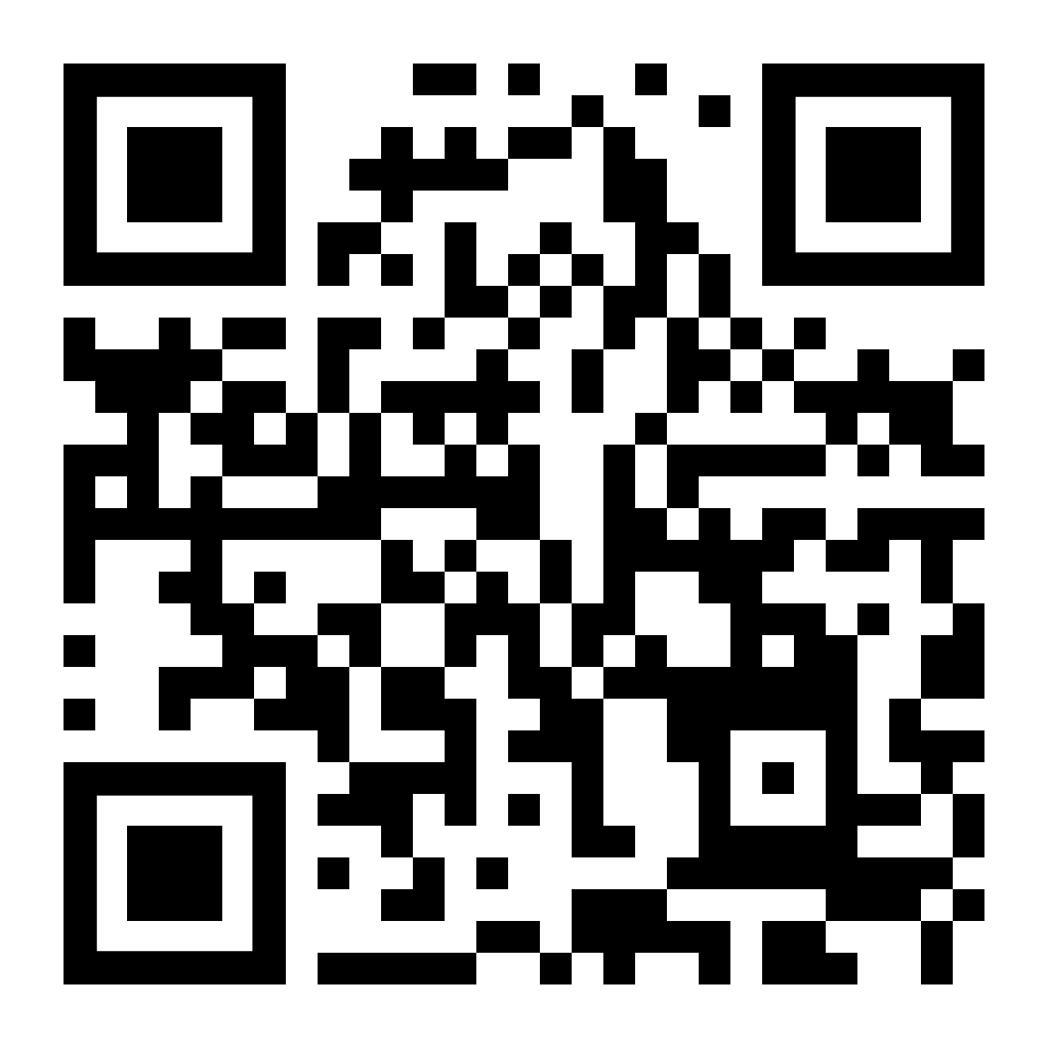
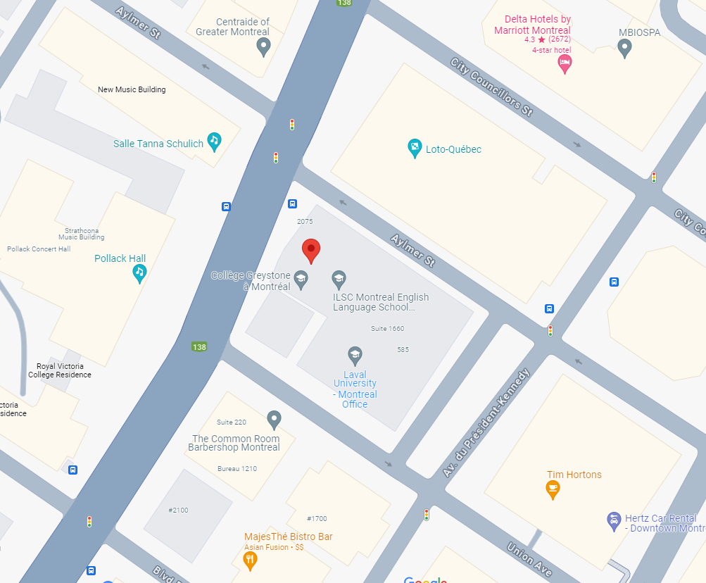
QLS-MiCM mission statement: deliver quality workshops designed to help biomedical researchers develop the skills they need to succeed.
Location: 550 Sherbrooke Street, Montreal, Quebec
Scan the QR code to sign up
for our mailing list
Contact: workshop-micm@mcgill.ca

Slide 3
Workshop Series
https://www.mcgill.ca/micm/training/workshops-series

Slide 4
Outline
Create a brief roadmap outlining the topics/content that will be covered in today's workshop

Slide 5
To summarize
Main point 1
Main point 2
Main point 3
Now you are ready to:
Learning outcome 1
Learning outcome 2
Learning outcome 3
Learning outcome 4
Learning outcome 5

Slide 6
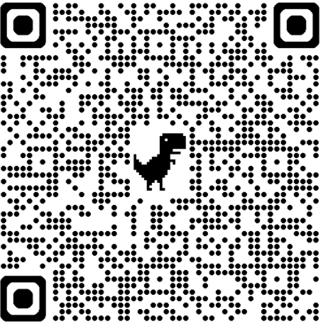
Thank you for attending!
  Scan the QR code to provide feedback on this workshop!

